Slide 1
Rayco material test
Yu Luan
June 14, 2017

Slide 2
Abstract
Rayco rubbers are molded to Delhi80 receiver suspension. The stability tests show failures with all chosen Rayco materials. The task is to measure the elastic modulus and damping of the Rayco rubbers, and find out the reason for the failure of stability test. At the end, a conclusion will be made for the usage of Rayco rubber in future designs.

Slide 3
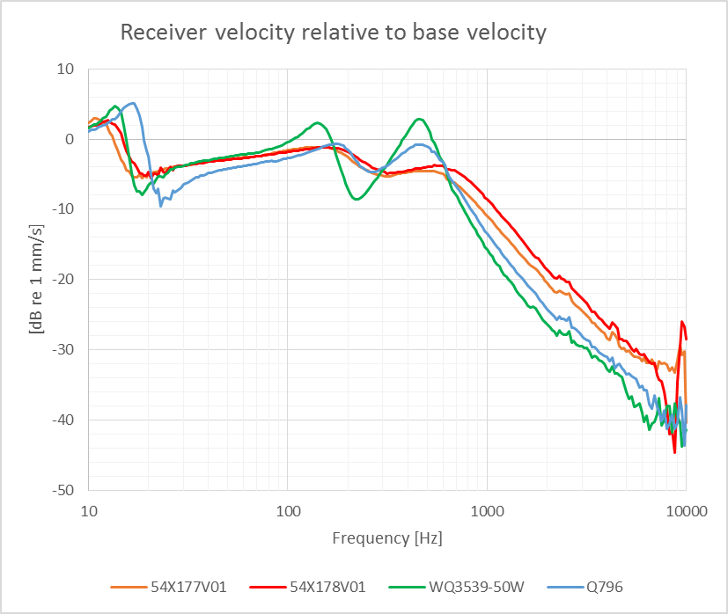
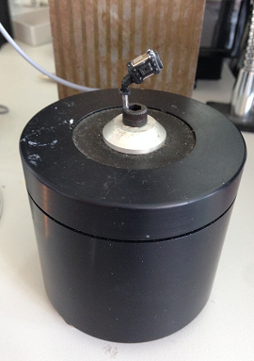
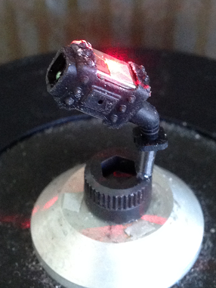
Finding material properties – experimental setup
The experiment setup is for measuring the material properties of the Rayco rubbers. The suspension with receiver is glued to a vibrating base (shaker). The velocities on receiver surface and base are measured with laser vibrometer, respectively.

Slide 4
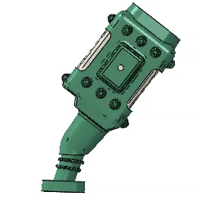
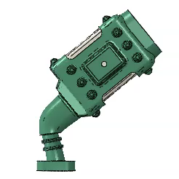
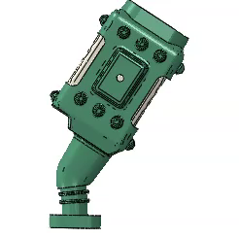
Finding material properties – Abaqus modelling
Abaqus models are made for the same setup.
The material properties have been found using parametrical optimization by comparing the simulated velocities to measured ones. We focus on the first peak (marked red in the figure), which is the bending resonance of lower part of the receiver suspension system.

Slide 5
Material properties list
Rubber type | Q796 | WQ3539-50W | 54X178V01 | 53X177V01
Elasticity modulus, E [Mpa] | 4.5 | 3.0 | 3.0 | 2.1
Damping loss factor, eta | 0.3 | 0.3 | 0.5 | 0.4
The Rayco rubbers are all softer than Q796. Moreover, the 54X178V01 and 54X177V01 have higher damping than Q796. The full data can be found in the attached excel file below.

Slide 6
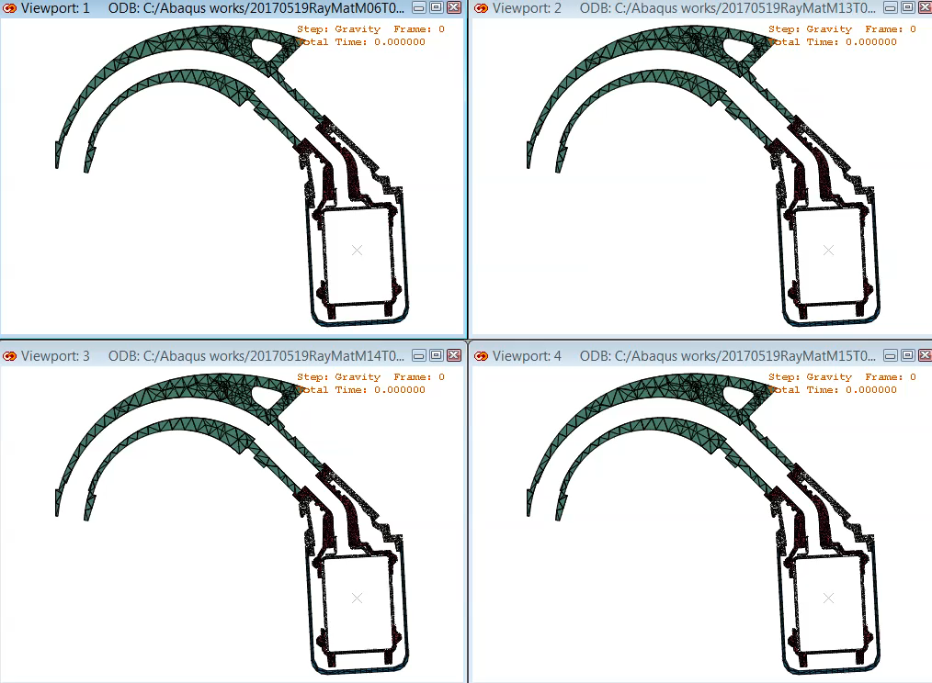
Stability test failure investigation
Gravity bends the suspension towards the walls of receiver can.
Q796 suspension does not touch the receiver can
The three Rayco rubber suspensions touch the receiver can.
Q796
WQ3539-50W
54X178V01
54X178V01

Slide 7
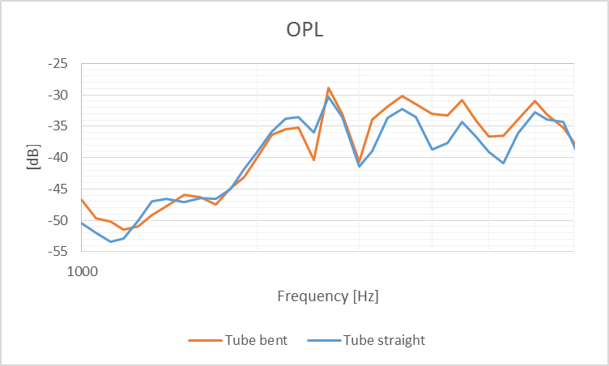
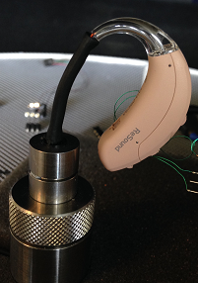
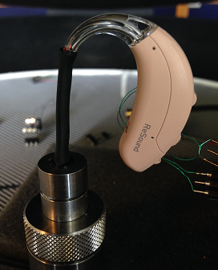
Stability test failure investigation
The OPL is measured with different HI orientation to show the OPL difference with/without touching noise. The suspension in this device is made of Rayco 54X177V01. The one with bent BTE tube gives a condition that the receiver suspension touches the receiver can; while with straight tube, it does not touch the receiver can. Therefore, the touching noise is presented with the bent tube OPL, and absent with the straight tube OPL. The difference is more than 2-5 dB in some frequency ranges.

Slide 8
Rayco rubber in Cambridge BTE13 mock up
Rayco rubber 54X177V01 is used as the material of receiver front suspension in the Abaqus models of Cambridge BTE13 mock up (Berlin70 hard mounted with RDL). FEA simulation shows that the Rayco rubber can be used in Cambridge BTE13 mock up.

Slide 9
Summarization
The material properties of Rayco rubbers are measured. They are all softer than Q796, and two of them have higher damping than Q796.
The reason of Delhi80 stability test failed with Rayco rubbers suspensions has been investigated. It is found that the gravity bends the rubber downward, so that the suspensions touch the receiver can.
The Rayco rubbers can be used for future designs. An FEA simulation of Cambrige BTE13 mock up using Rayco rubber as suspension shows the possibility of using Rayco rubbers for real designs.

